Slide 1
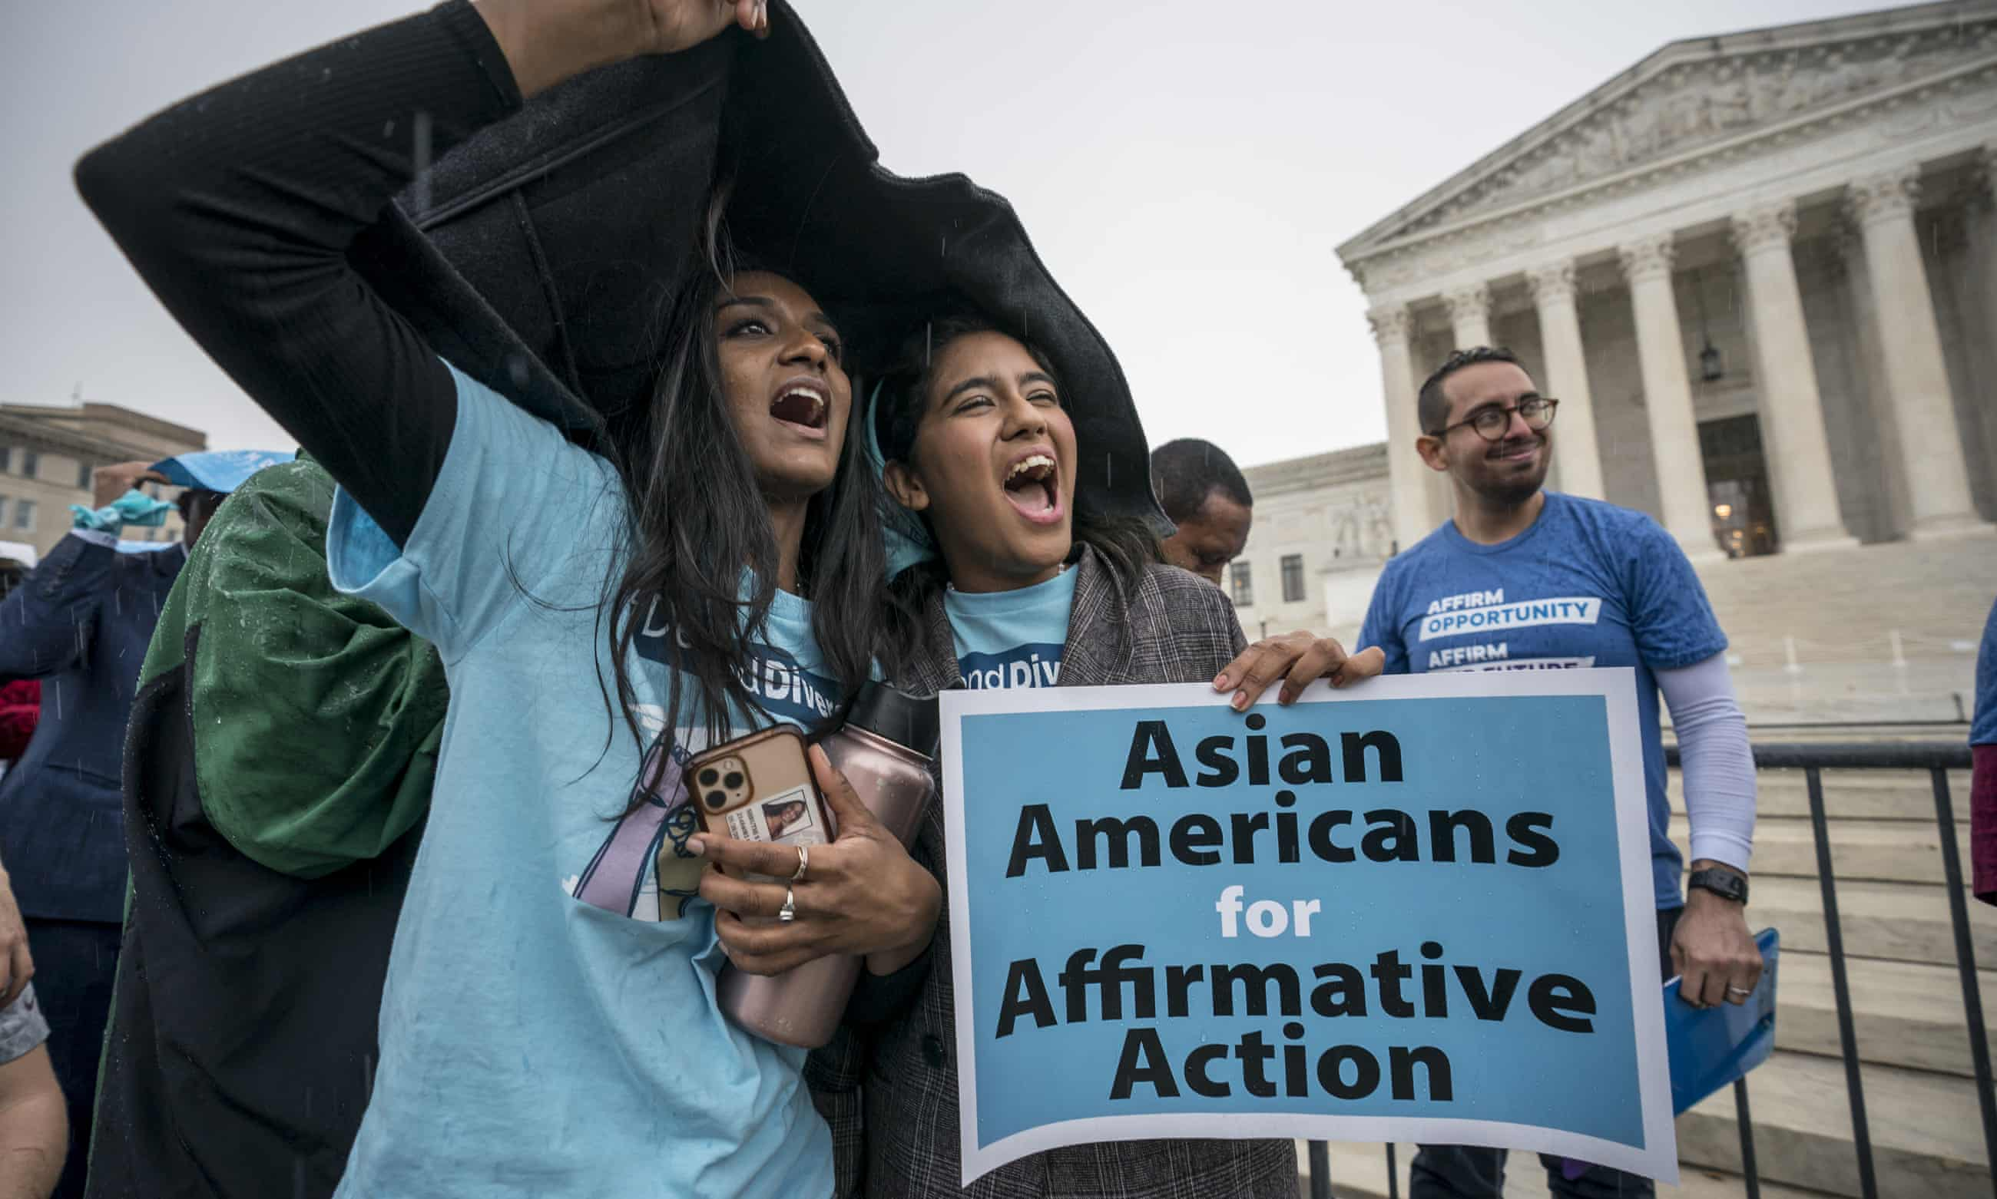
Presented By: Ananya Shandilya- 1044, Kohinoor-813, Bhupat-1276, Prince- 1252,
Rohit- 697

Slide 2
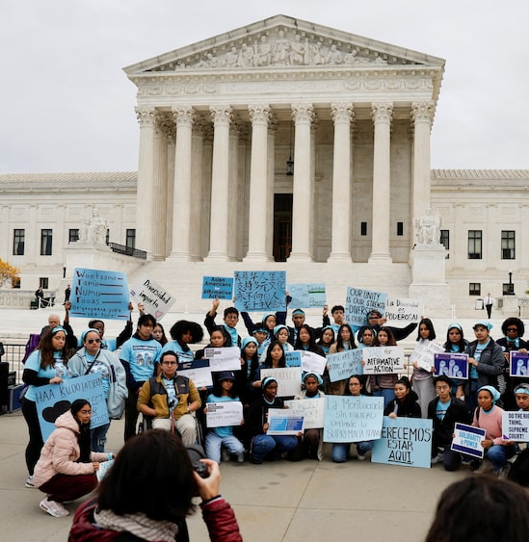
Introduction
The concept of affirmative action, tracing its historical development, landmark legal challenges, the arguments surrounding it, and its complex status today.

Slide 3
What is Affirmative Action?
Definition: Affirmative action refers to a set of policies and practices designed proactively to address past and present discrimination and to increase the representation of specific groups that have been historically underrepresented or excluded. These groups are often identified based on race, ethnicity, or gender.
Goals: Counteracting Discrimination, Promoting Diversity, Ensuring Equal Opportunity

Slide 4
Evolution and Historical Context
Origins: Affirmative action in the U.S. context largely emerged from the Civil Rights Movement of the 1950s and 1960s. The term gained prominence with President Kennedy's Executive Order 10925 (1961), requiring government contractors to take "affirmative action" to ensure non-discrimination.
President Johnson's Executive Order 11246 (1965) further solidified these requirements.

Slide 5
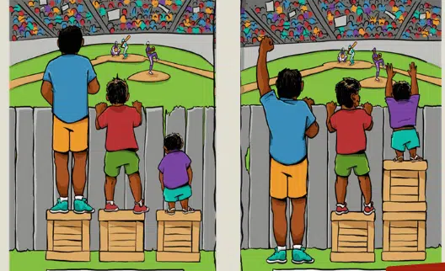
Evolution of Reservations in India
The reservation system in India has evolved over time through various historical, constitutional, and legal developments. It was initially introduced to uplift historically marginalized communities and has undergone multiple revisions to adapt to changing social and economic needs.

Slide 6
Evolution of Reservations in India
Pre-Independence Era (Colonial Period)
Post-Independence Era – Constitutional Provisions
The Mandal Commission and OBC Reservations (1979-1990)
Expanding Reservations – Recent Developments

Slide 7
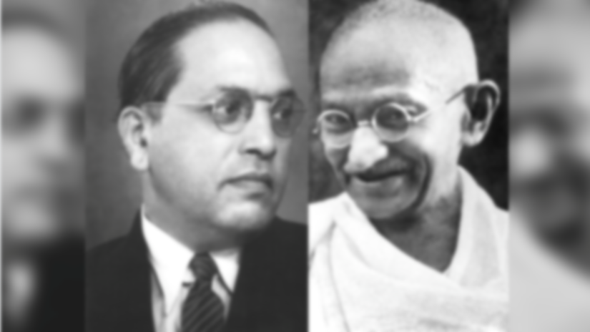
Pre-Independence Era (Colonial Period)
Early Initiatives: The British introduced caste-based reservations in education and jobs to address social inequalities.
1919 Government of India Act: Provided for representation of Dalits in legislatures.
Poona Pact (1932):
An agreement between Dr. B.R. Ambedkar and Mahatma Gandhi to reserve seats for Scheduled Castes (SCs) in legislative bodies.
Replaced separate electorates with joint electorates but ensured SC representation.
British Reforms: Some princely states like Mysore and Travancore introduced quotas for backward communities.
Evolution of Reservations in India

Slide 8
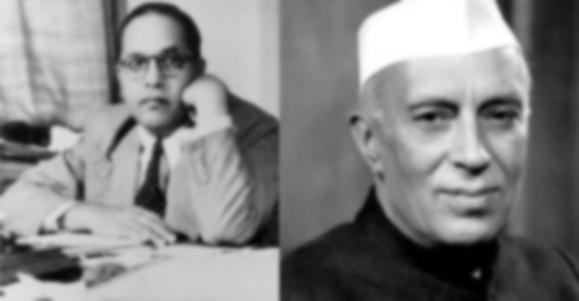
Post-Independence Era – Constitutional Provisions
After independence, the Indian Constitution (1950) institutionalized reservations to promote social justice.
Key provisions:
Article 15(4): Allows special provisions for socially and educationally backward classes.
Article 16(4): Enables reservation in government jobs for backward classes.
Article 46: Directs the state to promote the educational and economic interests of SCs, STs, and weaker sections.
Evolution of Reservations in India

Slide 9
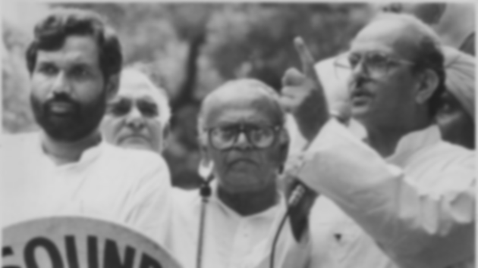
The Mandal Commission and OBC Reservations (1979-1990)
Mandal Commission (1979):
Recommended 27% reservation for Other Backward Classes (OBCs) in government jobs and educational institutions.
Identified 52% of India's population as OBC based on social and economic criteria.
Implementation in 1990:
Prime Minister V.P. Singh implemented 27% OBC reservations in central government jobs, leading to nationwide protests.
The Indra Sawhney Case (1992) upheld the policy but imposed a 50% cap on total reservations.
Evolution of Reservations in India

Slide 10
Landmark Cases Related to Reservations
The reservation system in India has been legally challenged and shaped by several key Supreme Court judgments. These cases have defined the scope, limits, and eligibility criteria for affirmative action policies.
Indra Sawhney v. Union of India (1992) – The Mandal Case
Ashoka Kumar Thakur v. Union of India (2008) – Higher Education Case
Maratha Reservation Case (2021) – Exceeding the 50% Cap
EWS Quota Case (2019) – Economic-Based Reservations

Slide 11
Indra Sawhney v. Union of India (1992) – The Mandal Case
Background:
The Mandal Commission (1979) recommended 27% reservations for Other Backward Classes (OBCs) in government jobs.
In 1990, Prime Minister V.P. Singh implemented these recommendations, sparking widespread protests.
The case was filed to challenge the constitutional validity of OBC reservations.
Landmark Cases Related to Reservations

Slide 12
Indra Sawhney v. Union of India (1992) – The Mandal Case
Supreme Court Verdict:
✔ Upheld 27% OBC reservations but introduced the creamy layer exclusion.
✔ Imposed a 50% cap on total reservations to maintain merit-based selections.
✔ Stated that reservation should not apply in promotions, only in initial appointments.
Impact:
This ruling set the foundation for OBC reservations in India.
The concept of the creamy layer ensured that economically well-off OBCs do not benefit from reservations, keeping the system focused on genuine social upliftment.
Landmark Cases Related to Reservations

Slide 13
Ashoka Kumar Thakur v. Union of India (2008) – Higher Education Case
Background:
In 2006, the Indian government extended 27% OBC reservations to centrally funded educational institutions like IITs, IIMs, and AIIMS.
Ashoka Kumar Thakur, a petitioner, challenged this, arguing that merit-based admissions were being compromised.
Landmark Cases Related to Reservations

Slide 14
Ashoka Kumar Thakur v. Union of India (2008) – Higher Education Case
Supreme Court Verdict:
✔ Upheld 27% OBC reservations in higher education.
✔ Exempted the creamy layer from OBC reservations.
✔ Affirmed the 50% reservation cap, meaning General Category must have at least 50% open seats.
✔ Clarified that private institutions were not required to implement reservations.
Impact:
This ruling cemented OBC reservations in premier institutions like IITs and IIMs.
Strengthened the creamy layer concept, ensuring that economically well-off OBCs do not misuse quotas.
Laid the groundwork for future economic-based reservations (EWS quota in 2019).
Landmark Cases Related to Reservations

Slide 15
Maratha Reservation Case (2021) – Exceeding the 50% Cap
Maharashtra passed a law granting 16% reservations to Marathas under the Socially and Educationally Backward Classes (SEBC) Act, 2018.
This took total reservations in Maharashtra beyond 50%, violating the Indra Sawhney judgment.
Supreme Court Verdict:
❌ Struck down Maratha reservations, reaffirming the 50% limit on reservations.
❌ Declared that states no longer have the power to identify backward classes, only the central government can do so.
Landmark Cases Related to Reservations

Slide 16
Maratha Reservation Case (2021) – Exceeding the 50% Cap
Impact:
This ruling prevented state governments from arbitrarily increasing reservations.
It reinforced the constitutional limit of 50% reservations.
It led to increased demands for constitutional amendments to extend reservations beyond the 50% cap.
Landmark Cases Related to Reservations

Slide 17
EWS Quota Case (2019) – Economic-Based Reservations
Background:
In 2019, the government introduced a 10% reservation for Economically Weaker Sections (EWS) from the General Category.
This was the first reservation based purely on economic criteria, not caste.
Supreme Court Verdict (2022):
✔ Upheld the 10% EWS reservation as constitutional.
✔ Clarified that EWS quotas do not violate the 50% limit, as they are an additional category.
✔ Confirmed that SCs, STs, and OBCs are not eligible for EWS reservations, as they already have caste-based quotas.
Landmark Cases Related to Reservations

Slide 18
EWS Quota Case (2019) – Economic-Based Reservations
Impact:
This ruling prevented state governments from arbitrarily increasing reservations.
It reinforced the constitutional limit of 50% reservations.
It led to increased demands for constitutional amendments to extend reservations beyond the 50% cap.
Landmark Cases Related to Reservations

Slide 19
EWS Quota Case (2019) – Economic-Based Reservations
Impact:
Opened the door for economic-based affirmative action, shifting the debate beyond caste.
Benefited financially weaker individuals from the General Category.
Sparked new demands for extending reservations to economically weaker sections within OBCs and SC/STs.
Landmark Cases Related to Reservations

Slide 20
Present Status of Reservations in India
SC/ST Reservations:
15% of government jobs and educational seats are reserved for Scheduled Castes (SCs).
7.5% of government jobs and educational seats are reserved for Scheduled Tribes (STs).
OBC Reservations:
27% of government jobs and education seats are reserved for OBCs (excluding the creamy layer).

Slide 21
Present Status of Reservations in India
EWS Category
A recent addition, 10% reservation for economically weaker sections among the unreserved category, ensuring opportunities for financially disadvantaged groups.
Political Reservations:
Reserved seats for SCs and STs in Parliament and state legislatures to ensure their representation in decision-making bodies.

Slide 22
Criticism and Support for Reservations
✅ Supporters argue:
Reservations reduce social and economic disparities by providing opportunities to historically oppressed communities.
They encourage social mobility and inclusive growth in India.
They rectify historical discrimination by ensuring equitable access to education and jobs.
👍🏼

Slide 23
Criticism and Support for Reservations
❌ Critics argue:
The system may be unfair to meritorious candidates who are denied opportunities despite higher qualifications.
Misuse of the system by well-off families within reserved categories (creamy layer issue).
Calls for economic-based reservations rather than caste-based reservations to ensure fairness.
👎🏼

Slide 24
Conclusion & Way Forward
Reservations remain a critical but debated aspect of India's social policies.
There is a need for better implementation and periodic policy reviews to ensure the benefits reach the intended groups.
Focus should shift towards economic and educational empowerment alongside reservations.
Alternative solutions include:
Skill development programs
Financial aid & scholarships
Policy reforms to reduce misuse

Slide 25
Thank You

